Slide 1
Generating a Land Cover Map for Lebanon
Using Sentinel Hub’s eo-learn & GEE’s Dynamic World
Boshra Ismail
Nourzahraa Mesmar
Mohammad Al Sobbahi

Slide 2
Agenda
01
02
03
04
05
06
Implementation
Introduction
Tools & Technologies
Challenges
Future Improvements
Conclusion

Slide 3
01
Introduction

Slide 4
Overview
• Land cover mapping is essential for environmental monitoring, urban planning, and resource management.
• This project focuses on generating a Land Cover Map for Lebanon using:
• Sentinel Hub’s eo-learn (for a single-time land cover classification).
• Google Earth Engine’s Dynamic World (for time-series land cover changes).

Slide 5
Objectives
• Develop a land cover classification map for Lebanon.
• Implement a time-series analysis to observe land cover changes.
• Utilize Sentinel-2 satellite data and machine learning techniques for classification.
• Compare the results from eo-learn and GEE Dynamic World.

Slide 6
Data Sources
• Sentinel-2 Imagery (Optical satellite images with high spatial resolution).
• Sentinel Hub’s Land Cover Data (Pre-labeled datasets).
• Dynamic World (Google Earth Engine) (Real-time land cover classification).

Slide 7
02
Tools & Technologies

Slide 8
Libraries and Tools
• Python (eo-learn library for data processing).
• Jupyter Notebook (Running the scripts).
• Google Earth Engine (GEE) (For cloud-based analysis).
• QGIS / Matplotlib (For visualization).

Slide 9
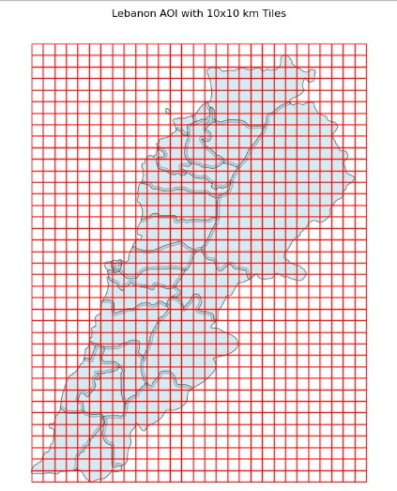
Workflow Overview
Approach 1: Using Sentinel Hub’s eo-learn
1. Define the Area of Interest (AOI) – Lebanon’s boundaries.
2. Data Preparation – Download Sentinel-2 images.
3. Feature Engineering – Compute indices (NDVI, NDWI).
4. Train Machine Learning Model (Random Forest).
5. Classify Land Cover and generate the final map.

Slide 10
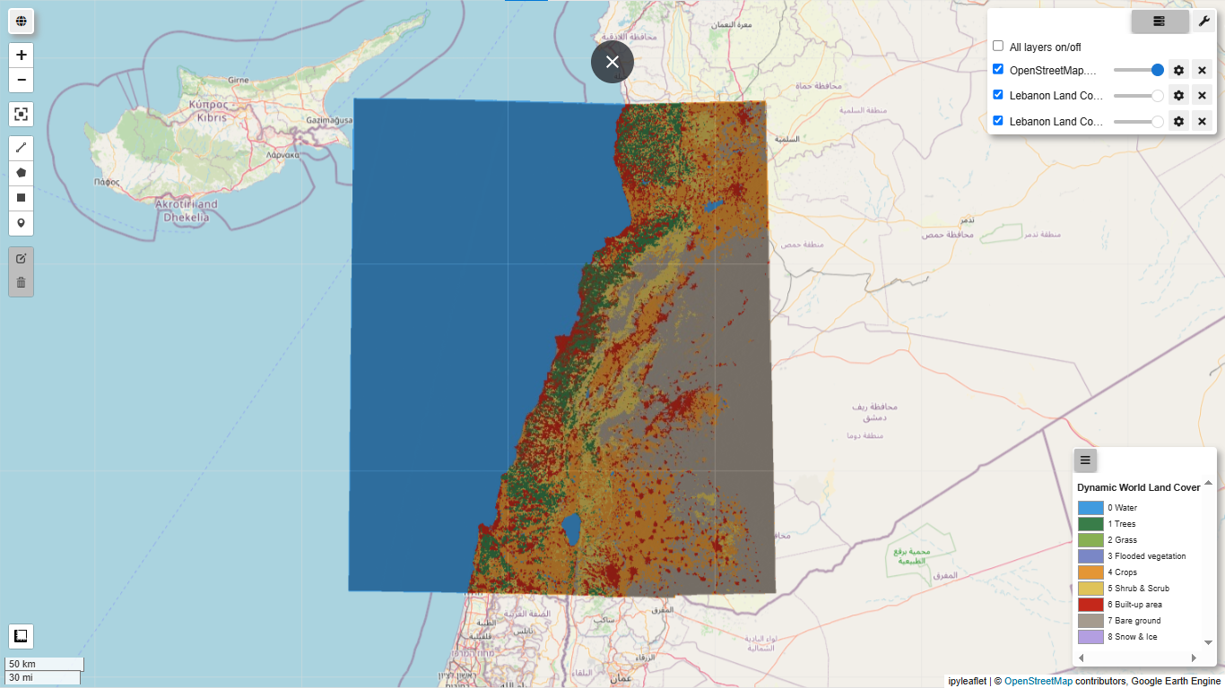
Workflow Overview
Approach 2: Using GEE Dynamic World
1. Import Dynamic World dataset into GEE.
2. Select Lebanon’s AOI and define a time range.
3. Process the images and classify land cover.
4. Generate a time-series animation of land cover changes.

Slide 11
03
Implementation

Slide 12
Techniques
Sentinel Hub’s eo-learn
GitHub Repository:
• SI_LULC_pipeline.ipynb
• Land Cover Map Example
GEE Dynamic World
GEE Notebooks Used:
• Land Cover Time-Series
• Land Cover Classification

Slide 13
Results
Expected Outcome:
A classified Land Cover Map identifying urban, forest, water, and agricultural areas
Insights into land use patterns for better decision-making
Support for environmental monitoring and urban planning

Slide 14
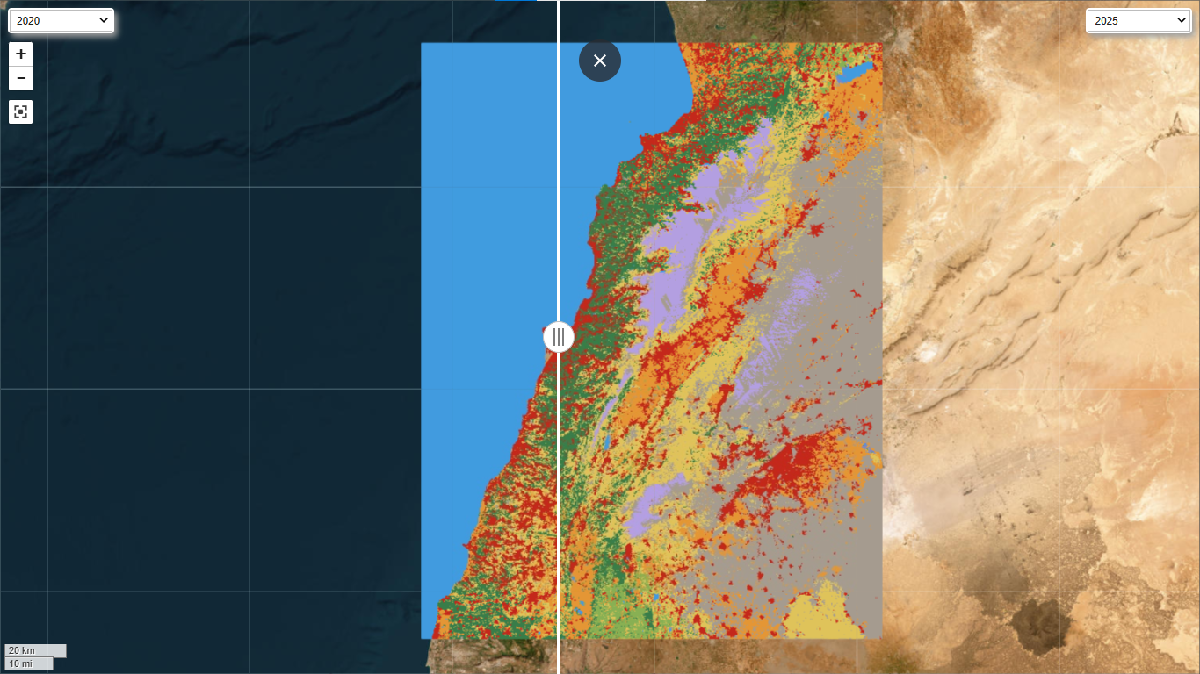
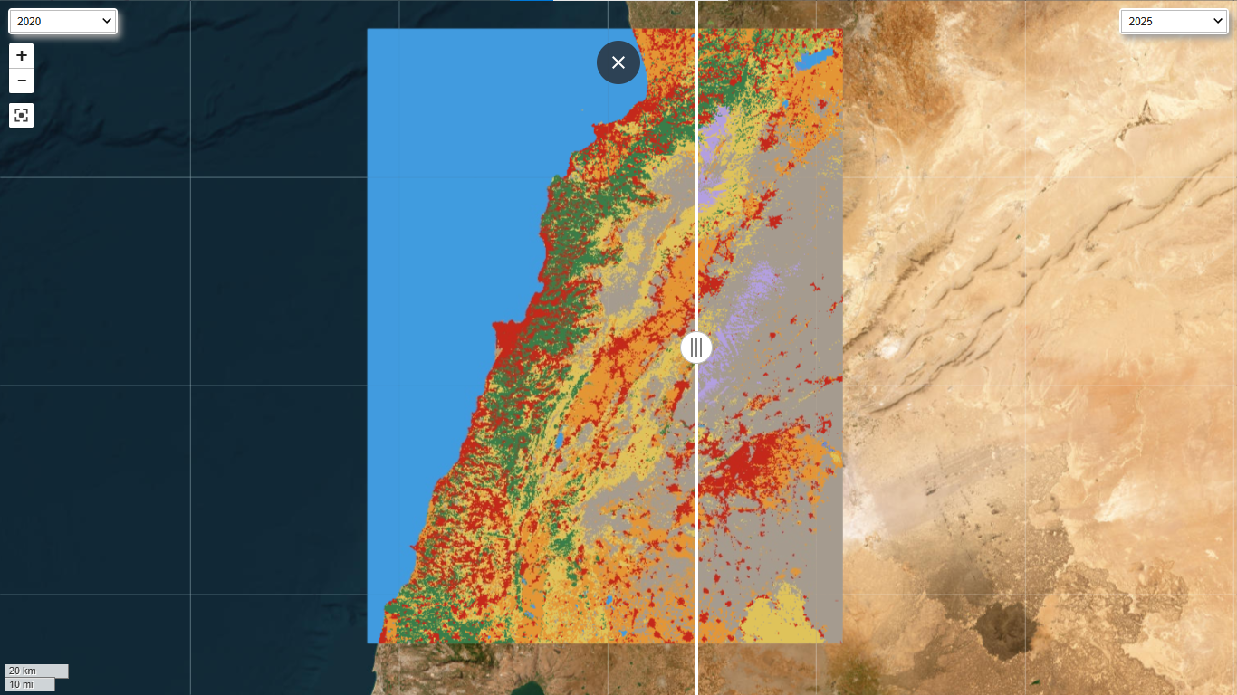
Results
Time-Series Land Cover Map
• Generated dynamic land cover maps over time.
• Identified land cover changes (e.g., urban expansion, deforestation).
• Time-lapse video shows land cover trends.

Slide 15
04
Challenges

Slide 16
Challenges
Data Preprocessing: Handling missing and cloudy images.
Computational Resources: Machine learning training is time-intensive.
Accuracy: Need for high-quality labeled training data.
API Limitations: Sentinel Hub and GEE have rate limits.

Slide 17
05
Future Improvements

Slide 18
Future Improvements
• Improve classification accuracy with Deep Learning models.
• Integrate multi-temporal analysis for better predictions.
• Use higher-resolution satellite imagery (Sentinel-3, Landsat-9).
• Develop a web-based dashboard for interactive visualization.

Slide 19
06
Conclusion

Slide 20
Thank You

